Slide 1
Under Guidance of Mrs. Vaishali Mam.

Slide 2
Introduction :
This project is based on amazon website automation using selenium web driver and java.
I automated multiple test cases such as login, product search, cart operations, profile management, address handling, category navigation, and language change.

Slide 3
Responsibilities
Designed and automated test cases using selenium web driver.
Implemented page object model (pom) for framework.
Executed test scripts for login, search, cart, profile, address, category, and language modules.
Created defect reports and documented issues.
Maintained scripts and handled synchronization/dynamic elements.

Slide 4
Tools & Technologies
Selenium WebDriver
Java
TestNG
Maven
Page Object Model (POM)

Slide 5
Overview
What is AMAZON?
Amazon is a leading e-commerce platform that provides users with online shopping features such as login, product search, add to cart, checkout, profile management, and settings.
In this project:
I automated key user workflows on amazon using selenium web driver with java.
The project focused on testing real-time features like login, searches, product selection, cart operations, user profile updates, address handling, category navigation, and changing country language.
The goal was to validate functionality and ensure automation scripts can be reused across test cases using page object model (pom).

Slide 6
Modules
Module 1 : Login page - valid & invalid logins
Checked all the functionalities on sign in page which included personal info as email and password.
Module 2 : Multiple searches
Verified search functionality by entering different product names like mobiles, laptops, and clothing.
Validated that results are relevant to the search keyword.
Notes:
Module 1: Signn in page
Checked all the functionalities on Sign in page which included personal info as email
address, password
Module 2: Women page
Checked all the functionalities on Women page which included item details, Quantity, Filters,compare button,Add to cart button,product info,grid,list button
Module 3: Tshirt page
Checked all the functionalities on T-Shirt page which included item details, Quantity, Filters,compare button,Add to cart button,product info,grid,list button
Module 4: All Buttons and Drop Down Arrow :
team checked if all the buttons and drop down arrows of different fields are functioning properly or not

Slide 7
Module 3 : ADD TO CART & DELETE - CART OPERATIONS
Module 4 : Change Username - Profile edit automation
Automated adding a product to the cart and checked that it was added successfully.
Verified deleting a product from the cart and ensured cart was updated correctly.
Confirmed cart shows empty when no items are left.
Automated editing the profile and updated the username.
Verified that the new username was saved and displayed correctly.

Slide 8
Module 5 : Add New Address - Address form automation
Automated filling the new address form with details like name, phone, and location.
Saved the address and verified it was added in the address list.
Module 6 : Shop by Category - Navigation through categories
Module 7 : Change Language - Switch site language
Automated selecting different categories like mobiles, electronics, and fashion.
Verified that the selected category page opened with related products.
Automated changing the site language from English to another available language.
Verified that the website content was updated according to the selected language.

Slide 9
Defects
While running a testcase at certain point some fields are not working as it is expected which is nothing but a defect, so I have created a defect report on those defects.

Slide 10
Defect identifier :- B_001
Defect 1
Defect ID: B_001
Defect Summary: Username field accepts a single character which should not be allowed.
Test ID: TC_004
Test Case Name: TC _ Change _ Username _ Validation
Module Name: Profile Management
Reproducible: Yes
Severity: Medium
Priority: Medium
Raised By: Bharadwaj
Assigned To: Developer
Status: Pending
Fixed By: –
Date of Fixing: –

Slide 11
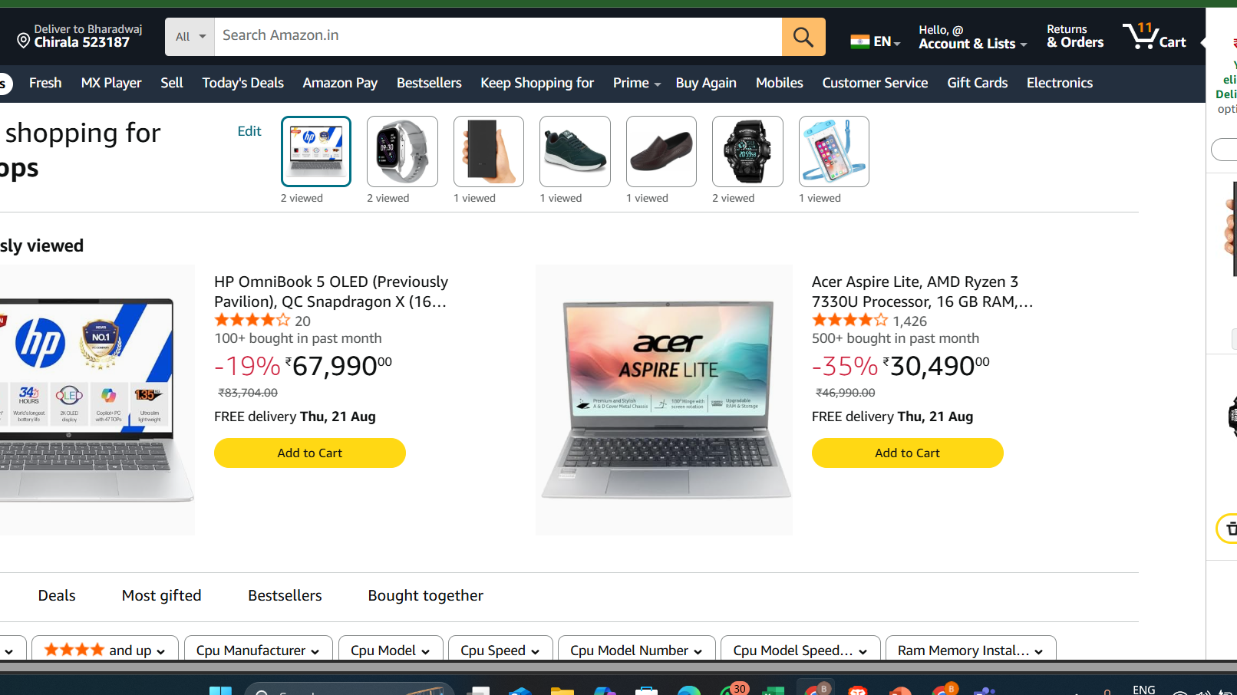

Slide 12
Defect identifier :- B_002
Defect ID: B_002
Defect Summary: System allows adding quantity above 10, which should not be permitted.
Test ID: TC_002
Test Case Name: TC _ Add _ Product _ Quantity _ Limit
Module Name: Cart Operations
Reproducible: Yes
Severity: Medium
Priority: High
Raised By: Bharadwaj
Assigned To: Developer
Status: Pending
Fixed By: –
Date of Fixing: –

Slide 13
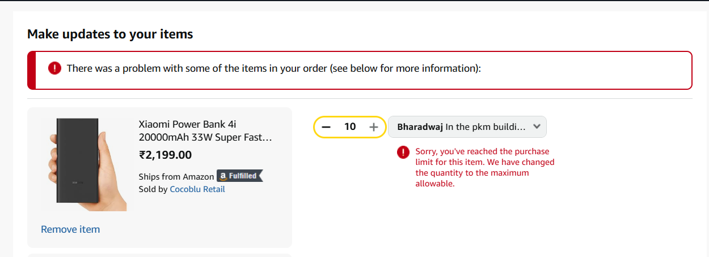

Slide 14
Challenges
While testing website I faced some challenges about:
Handling dynamic x paths and locators
Synchronization issues solved using explicit waits
Managing dropdowns and frames

Slide 15
Experience
Learned selenium automation framework end-to-end
Implemented page object model for reusable scripts
Gained confidence in handling synchronization issues
Improved observation skills and considered all possible user scenarios via manual testing.

Slide 16
Thank You!!!
Vaishali Mam For Guiding Us through out the Project.
Name: Bharadwaj Achimsetty

